Slide 1


Introduction of AI Agents
Presented by: Sourour Hammoud
August 2,2025

Slide 2

Plan:
What are LLMs?
What are AI Agents?
Components of AI Agents
Cycles of AI Agents
Types of Agents
When to use AI Agents
AI Agent Frameworks
Tool Use Design Pattern
Agentic Design Principles
Guardrails

Slide 3


What are llmS?

Slide 4
An LLM is a type of AI model that excels at understanding and generating human language It learns by reading huge amounts of text, so it can understand how language works. Most modern LLMs use something called a Transformer.
TYPES OF TRANSFORMER
ENCODER
DECODER
SEQ2SEQ

Slide 5
TYPES OF ENCODER:
BERT
RoBERTa

Slide 6
TYPES OF DECODER:
GEEDY DECODING
BEAM SEARCH

Slide 7
What are AI AGENTS?

Slide 8
AI Agents are an AI Model that can reason, plan and use tools to interact with its environment to achieve a specific goals.
The concept of agents existed before the creation of LLMs (Large Language Models). The advantage of building AI Agents with LLMs is their ability to interpret human language and data.

Slide 9
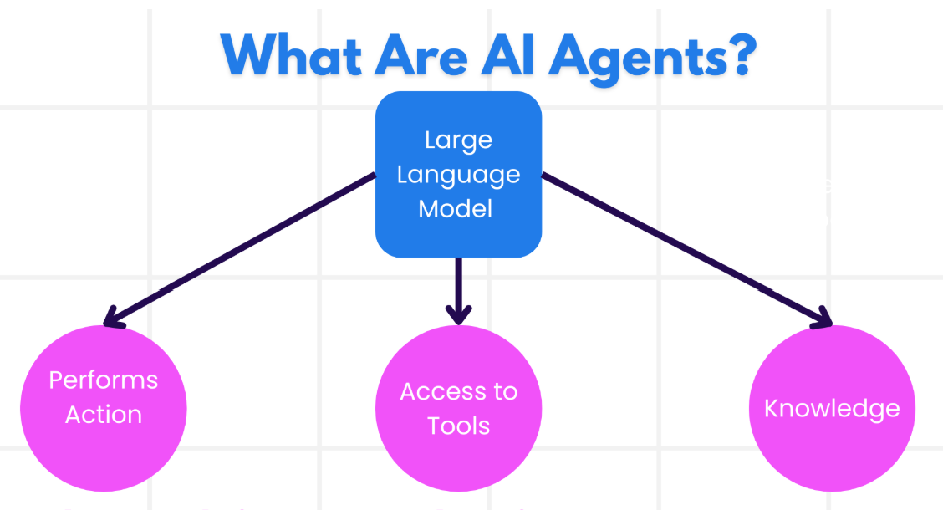

Slide 10
Components of ai agents

Slide 11


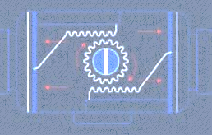
ENVIRONMENT
SENSORS
ACTUATORS

Slide 12
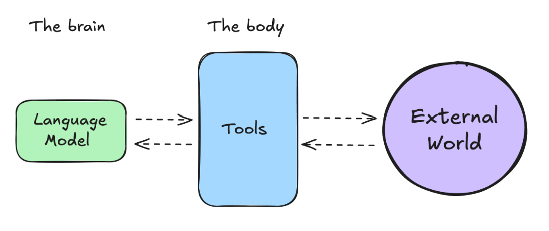

Slide 13
CYCLES OF AI AGENTS

Slide 14
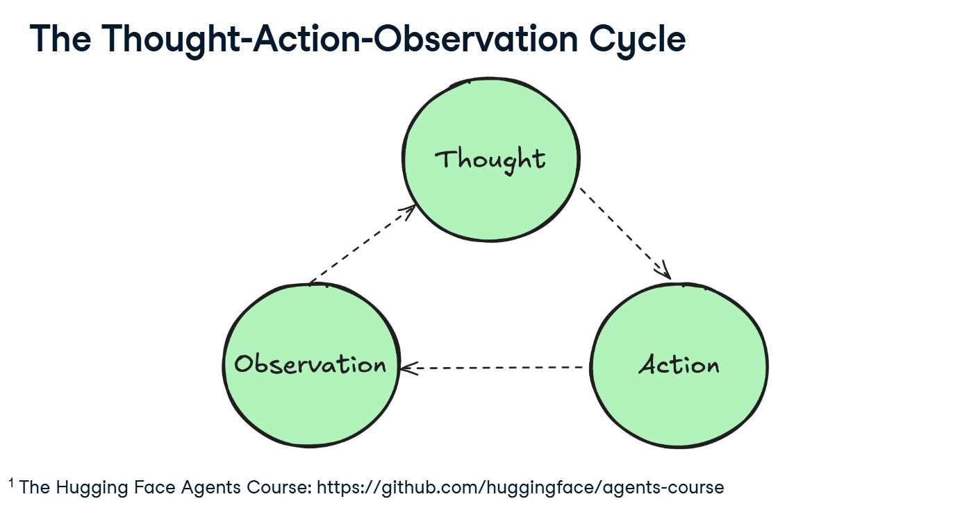

Slide 15
TYPES OF THOUGHT:
Planning
Decision Making
Problem Solving
Memory Integration
Analysis
Self Reflection
Goal Setting
Prioritization

Slide 16
TYPES OF AGENT ACTION FORMAT:
JSON File
Code Agent
Function Calling Agent
TYPES OF ACTION:
Information Gathering
Tool Usage
Environment Interaction
Communication

Slide 17
TYPES OF OBSERVATION:
System Feedback
Data Changes
EnvironmentData
Response Analysis
Time-based Events

Slide 18
TYPES OF AGENTS

Slide 19







SIMPLE REFLEX AGENTS
MODEL BASED REFLEX AGENTS
GOAL BASED AGENTS
UTILITY BASED AGENTS
LEARNING AGENTS
HIERARCHICAL AGENTS
MULTI AGENTS SYSTEMS(MAS)

Slide 20
WhEN TO USE AI AGENTS

Slide 21
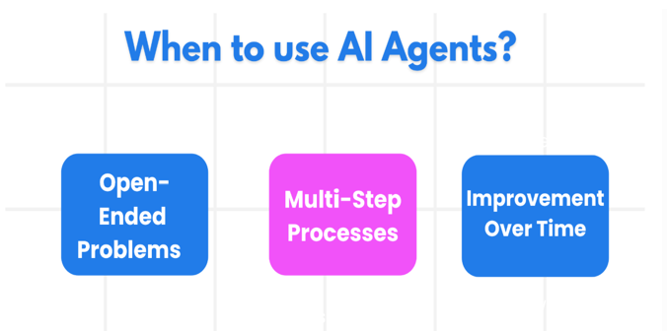

Slide 22
AI AGENT FRAMEWORKS

Slide 23
Traditional AI Frameworks can help you integrate AI into your apps and make these apps better in the following ways:
-Personalization: AI can analyze user behavior and preferences to provide personalized recommendations, content, and experiences.
-Automation and Efficiency: AI can automate repetitive tasks, streamline workflows, and improve operational efficiency.
- Enhanced User Experience: AI can improve the overall user experience by providing intelligent features such as voice recognition, natural language processing, and predictive text.

Slide 24
Use Modular Components: AI Agent frameworks like Microsoft Semantic Kernel and Lang Chain give you ready-made parts like AI connectors, memory tools, and prompt templates. These help teams build smart systems quickly without starting from zero.
Leverage Collaborative Tools: Leverage collaboration tools means using AI tools to create agents that work together. Each agent does a different job, like finding data or making decisions. Together, they solve tasks faster and better.
Learn in Real-Time: AI agents can learn while working. They look at what happens, learn from mistakes, and do better next time. This helps them improve over time.

Slide 25
The differences between AutoGen, Semantic Kernel and Azure AI Agent Service are:
Framework | Focus | Core Concepts | Use Cases
AutoGen | Event-driven, distributed agentic applications | Agents, Personas, Functions, Data | Code generation, data analysis tasks
Semantic Kernel | Understanding and generating human-like text content | Agents, Modular Components, Collaboration | Natural language understanding, content generation
Azure AI Agent Service | Flexible models, enterprise security, Code generation, Tool calling | Modularity, Collaboration, Process Orchestration | Secure, scalable, and flexible AI agent deployment

Slide 26
TOOL USE DESIGN PATTERN

Slide 27
The Tool Use Design Pattern focuses on giving LLMs the ability to interact with external tools to achieve specific goals. Tools are code that can be executed by an agent to perform actions.
CASES TO USE THESE TOOLS
Code Execution and Interpretation
Workflow Automation
Dynamic Information Retrieval
Content Generation and Editing
Customer Support

Slide 28
Key Elements of the Tool Use Design Pattern:
Function/Tool Schemas: describe each tools, its name, what it does, input needs and what it returns.
Function Execution Logic: Decides when and how to use tools based on the user’s message and the context of the conversation.
Message Handling System: Manages the flow between the user, the AI, tool requests and tool responses.
Tool Integration Framework: Connect the Agent to actual tools.
Error Handling and Validation: Catches problems like missing or incorrect input, failed tool calls and ensure responses make sense.
State Management: Tracks conversation context, previous tool interactions, and persistent data to ensure consistency across multi-turn interactions.

Slide 29
AGENTIC DESIGN PRINCIPLES

Slide 30



SPACE
TIME
CORE

Slide 31
GUARDRAILS

Slide 32
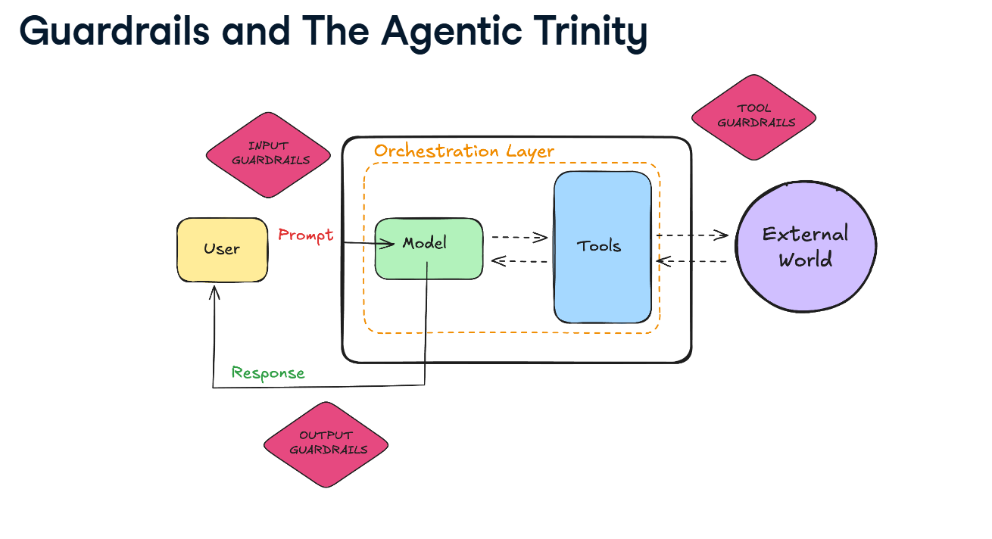

Slide 33
Thank You!

